Slide 1
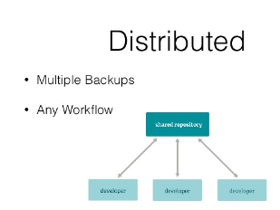
GIT:
Git is a distributed version-control system for tracking changes in source code during software
development. It is designed for coordinating work among programmers, but it can be used
to track changes in any set of files. Its goals include speed, data integrity, and support for
distributed, non-linear workflows.

Slide 2
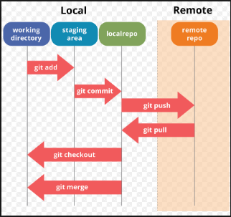
GIT Architecture:

Slide 3
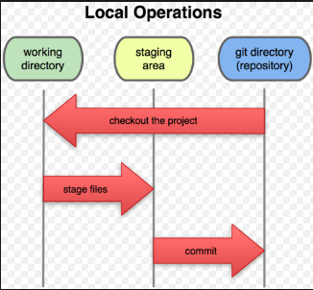
GIT Local Operations:

Slide 4
Git Commands:
git init---Create a new local repository
git clone---Create a working copy of a local repository
git add---Add one or more files to staging
git commit -m "Commit message“ --- Commit changes to head
git commit –a --Commit any files you've added with git add, and also commit any files you've
changed since the
git push origin master --- Send changes to the master branch of your remote repository
git status ----List the files you've changed and those you still need to add or commit.
git checkout –b--- Create a new branch and switch to it.
git checkout---- Switch from one branch to another.
git push origin ---- Push the branch to your remote repository, so others can use it.
git branch –d --- Delete the feature branch
git push --all origin --- Push all branches to your remote repository
git pull --- Fetch and merge changes on the remote server to your working director
git merge --- To merge a different branch into your active branch
git diff ---- View all the merge conflicts:View the conflicts against the base file

